Slide 1
Database Management System (MDS 505)
Jagdish Bhatta
Jagdish Bhatta

Slide 2
Unit -3
Database Constraints and Normalization
Jagdish Bhatta
Notes:
Jagidsh Bhatta

Slide 3
Database Constraints
Already covered in unit 2.
Refer 2.1 Relational Model.
Jagdish Bhatta
Notes:
Jagidsh Bhatta

Slide 4
Assertions
ASSERTION, which can be used to specify additional types of constraints that are outside the scope of the built-in relational model constraints (primary and unique keys, entity integrity, and referential integrity).
Each assertion is given a constraint name and is specified via a condition similar to the WHERE clause of an SQL query.
An assertion is a predicate expressing a condition we wish the database to always satisfy.
Domain constraints, functional dependency and referential integrity are special forms of assertion.
Syntax:
create assertion assertion-name check predicate
Jagdish Bhatta
Notes:
Jagidsh Bhatta

Slide 5
Assertions
For example, to specify the constraint that the salary of an employee must not be greater than the salary of the manager of the department that the employee works for in SQL, we can write the following assertion:
  CREATE ASSERTION SALARY_CONSTRAINT
  CHECK
  (
  NOT EXISTS ( SELECT *
  FROM EMPLOYEE E, EMPLOYEE M, DEPARTMENT D
  WHERE E.Salary>M.Salary AND E.Dno = D.Dnumber AND D.Mgr_ssn = M.Ssn )
  );
Jagdish Bhatta
Notes:
Jagidsh Bhatta

Slide 6
Assertions
The constraint name SALARY_CONSTRAINT is followed by the keyword CHECK, which is followed by a condition in parentheses that must hold true on every database state for the assertion to be satisfied.
The constraint name can be used later to disable the constraint or to modify or drop it. The DBMS is responsible for ensuring that the condition is not violated. Any WHERE clause condition can be used, but many constraints can be specified using the EXISTS and NOT EXISTS style of SQL conditions.
Whenever some tuples in the database cause the condition of an ASSERTION statement to evaluate to FALSE, the constraint is violated. The constraint is satisfied by a database state if no combination of tuples in that database state violates the constraint.
By including this query inside a NOT EXISTS clause, the assertion will specify that the result of this query must be empty so that the condition will always be TRUE. Thus, the assertion is violated if the result of the query is not empty. In the preceding example, the query selects all employees whose salaries are greater than the salary of the manager of their department. If the result of the query is not empty, the assertion is violated.
Jagdish Bhatta
Notes:
Jagidsh Bhatta

Slide 7
Assertions
A major difference between CREATE ASSERTION and the individual domain constraints and tuple constraints is that the CHECK clauses on individual attributes, domains, and tuples are checked in SQL only when tuples are inserted or updated in a specific table. Hence, constraint checking can be implemented more efficiently by the DBMS in these cases. The schema designer should use CHECK on attributes, domains, and tuples only when he or she is sure that the constraint can only be violated by insertion or updating of tuples.
On the other hand, the schema designer should use CREATE ASSERTION only in cases where it is not possible to use CHECK on attributes, domains, or tuples, so that simple checks are implemented more efficiently by the DBMS.
When an assertion is created, the system tests it for validity. If the assertion is valid, any further modification to the database is allowed only if it does not cause that assertion to be violated. This testing may result in significant overhead if the assertions are complex. Because of this, the assert should be used with great care. Some system developer omits support for general assertions or provides specialized form of assertions that are easier to test.
Jagdish Bhatta
Notes:
Jagidsh Bhatta

Slide 8
Triggers
In many cases it is convenient to specify the type of action to be taken when certain events occur and when certain conditions are satisfied. For example, it may be useful to specify a condition that, if violated, causes some user to be informed of the violation. A manager may want to be informed if an employee’s travel expenses exceed a certain limit by receiving a message whenever this occurs. The action that the DBMS must take in this case is to send an appropriate message to that user. The condition is thus used to monitor the database. Other actions may be specified, such as executing a specific stored procedure or triggering other updates. The CREATE TRIGGER statement is used to implement such actions in SQL.
Jagdish Bhatta
Notes:
Jagidsh Bhatta

Slide 9
Triggers
Suppose we want to check whenever an employee’s salary is greater than the salary of his or her direct supervisor in the COMPANY database.
Several events can trigger this rule: inserting a new employee record, changing an employee’s salary, or changing an employee’s supervisor. Suppose that the action to take would be to call an external stored procedure SALARY_VIOLATION,5 which will notify the supervisor.
    CREATE TRIGGER SALARY_VIOLATION
    BEFORE INSERT OR UPDATE OF SALARY, SUPERVISOR_SSN
    ON EMPLOYEE
    FOR EACH ROW
    WHEN ( NEW.SALARY > ( SELECT SALARY FROM EMPLOYEE
    WHERE SSN = NEW.SUPERVISOR_SSN ) )
    INFORM_SUPERVISOR (NEW.Supervisor_ssn,
    NEW.Ssn );
Jagdish Bhatta
Notes:
Jagidsh Bhatta

Slide 10
Triggers
The trigger is given the name SALARY_VIOLATION, which can be used to remove or deactivate the trigger later. A typical trigger which is regarded as an ECA (Event, Condition, Action) rule has three components:
  The event(s): These are usually database update operations that are explicitly applied to the database. In this example the events are: inserting a new employee record, changing an employee’s salary, or changing an employee’s supervisor. The person who writes the trigger must make sure that all possible events are accounted for. In some cases, it may be necessary to write more than one trigger to cover all possible cases. These events are specified after the keyword BEFORE in our example, which means that the trigger should be executed before the triggering operation is executed. An alternative is to use the keyword AFTER, which specifies that the trigger should be executed after the operation specified in the event is completed.
  The condition that determines whether the rule action should be executed: Once the triggering event has occurred, an optional condition may be evaluated. If no condition is specified, the action will be executed once the event occurs. If a condition is specified, it is first evaluated, and only if it evaluates to true will the rule action be executed. The condition is specified in the WHEN clause of the trigger.
  The action to be taken: The action is usually a sequence of SQL statements, but it could also be a database transaction or an external program that will be automatically executed. In this example, the action is to execute the stored procedure INFORM_SUPERVISOR.
Jagdish Bhatta
Notes:
Jagidsh Bhatta

Slide 11
Triggers
The following AFTER trigger simply prints ‘In the After Trigger’ when the trigger is executed:
  USE Family;
  CREATE TRIGGER TriggerOne ON Person
  AFTER INSERT
  AS
  PRINT ‘In the After Trigger’;
With the AFTER trigger enforced, the following code inserts a sample row:
  INSERT Person(PersonID, LastName, FirstName, Gender)
  VALUES (50, ‘Ebob’, ‘Bill’,‘M’);
Result:
  In the After Trigger
Jagdish Bhatta
Notes:
Jagidsh Bhatta

Slide 12
Stored Procedures
A stored procedure (also termed proc, storp, sproc, StoPro,
StoredProc, StoreProc, sp, or SP) is a subroutine available to applications that access a relational database management system (RDBMS). Such procedures are stored in the database data dictionary.
Uses for stored procedures include data-validation (integrated into the database) or access-control mechanisms.
Stored routines can be particularly useful in certain situations when multiple client applications are written in different languages or work on different platforms, but need to perform the same database operations.
Jagdish Bhatta
Notes:
Jagidsh Bhatta

Slide 13
Stored Procedures
Create, alter and drop:
CREATE must be the first command in a batch; the termination of the batch ends the creation of the stored procedure. The following example creates a very simple stored procedure that retrieves data from the ProductCategory table :
    CREATE PROCEDURE CategoryList
    AS
    SELECT ProductCategoryName, ProductCategoryDescription
    FROM ProductCategory;
Jagdish Bhatta
Notes:
Jagidsh Bhatta

Slide 14
Executing a Stored Procedure
When calling a stored procedure within a SQL batch, the EXECUTE or CALL command executes the stored procedure with a few special rules. EXECUTE is typically coded as EXEC.
For Eg.: EXEC/CALL dbo.CategoryList;
Jagdish Bhatta
Notes:
Jagidsh Bhatta

Slide 15
Passing Data to Stored Procedure
A stored procedure is more useful when it can be manipulated by parameters. The CategoryList stored procedure created previously returns all the product categories, but a procedure that performs a task on an individual row requires a method for passing the row ID to the procedure.
Jagdish Bhatta
Notes:
Jagidsh Bhatta

Slide 16
Passing Data to Stored Procedure
Input parameters
You can add input parameters that pass data to the stored procedure by listing the parameters after the procedure name in the CREATE PROCEDURE command
Each parameter must begin with an @ sign, and becomes a local variable within the procedure. Like local variables, the parameters must be defined with valid data types. When the stored procedure is called, the parameter must be included (unless the parameter has a default value).
The following code sample creates a stored procedure that returns a single product category. The value passed by means of the parameter is available within the stored procedure as the variable @CategoryName in the WHERE clause:
Jagdish Bhatta
Notes:
Jagidsh Bhatta

Slide 17
Passing Data to Stored Procedure
Input parameters
CREATE PROCEDURE CategoryGet (@CategoryName VARCHAR(35))
    AS
    SELECT ProductCategoryName, ProductCategoryDescription
    FROM ProductCategory
    WHERE ProductCategoryName = @CategoryName;
Jagdish Bhatta
Notes:
Jagidsh Bhatta

Slide 18

Passing Data to Stored Procedure
When the following code sample is executed, the Unicode string literal ‘Kite’ is passed to the stored procedure and substituted for the variable in the WHERE clause:
EXEC CategoryGet ’Kite’;
Result:
Jagdish Bhatta
Notes:
Jagidsh Bhatta

Slide 19
Passing Data to Stored Procedure
If multiple parameters are involved, the parameter name can be specified in any order, or the parameter values listed in order. If the two methods are mixed, then as soon as the parameter is provided by name, all the following parameters must be as well.
The next four examples each demonstrate calling a stored procedure and passing the parameters by original position and by name:
EXEC Schema.StoredProcedure
@Parameter1 = n,
@Parameter2 = ‘n’;
EXEC Schema.StoredProcedure
@Parameter2 = ‘n’,
@Parameter1 = n;
EXEC Schema.StoredProcedure n, ‘n’;
EXEC Schema.StoredProcedure n, @Parameter2 = ‘n’;
Jagdish Bhatta
Notes:
Jagidsh Bhatta

Slide 20
Passing Data to Stored Procedure
Parameter defaults
You must supply every parameter when calling a stored procedure, unless that parameter has been created with a default value. You establish the default by appending an equal sign and the default to the parameter, as follows;
CREATE PROCEDURE StoredProcedure
(
@Variable DataType = Default Value
)
Jagdish Bhatta
Notes:
Jagidsh Bhatta

Slide 21
Passing Data to Stored Procedure
Parameter defaults
The following code, demonstrates a stored procedure default. If a product category name is passed in this stored procedure, the stored procedure returns only the selected product category. However, if nothing is passed, the NULL default is used in the WHERE clause to return all the product categories:
  CREATE PROCEDURE pProductCategory_Fetch2
  ( @Search VARCHAR(50) = NULL)
  AS
  SELECT ProductCategoryName, ProductCategoryDescription
  FROM ProductCategory
  WHERE ProductCategoryName = @Search OR @Search IS NULL;
Jagdish Bhatta
Notes:
Jagidsh Bhatta

Slide 22

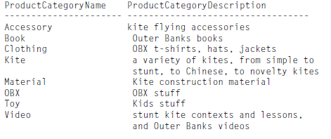
Passing Data to Stored Procedure
Parameter defaults
The first execution passes a product category:
EXEC dbo.pProductCategory_Fetch2 ‘OBX’;
Result:
When pProductCategory_Fetch executes without a parameter, the @Search parameter’s default of NULL allows the WHERE clause to evaluate to true for every row, as follows:
EXEC dbo.pProductCategory_Fetch2;
Jagdish Bhatta
Notes:
Jagidsh Bhatta

Slide 23
Returning Data from Stored Procedure
Output Parameter defaults
Output parameters enable a stored procedure to return data to the calling client procedure. The keyword OUTPUT is required both when the procedure is created and when it is called. Within the stored procedure, the output parameter appears as a local variable. In the calling procedure or batch, a variable must have been created to receive the output parameter. When the stored procedure concludes, its current value is passed to the calling procedure’s local variable.
Eg:
  CREATE PROC GetProductName (
  @ProductCode CHAR(10),
  @ProductName VARCHAR(25) OUTPUT
  )
  AS
  SELECT @ProductName = ProductName
  FROM Product
  WHERE Code = @ProductCode;
  RETURN;
Jagdish Bhatta
Notes:
Jagidsh Bhatta

Slide 24
Returning Data from Stored Procedure
Output Parameter defaults
  DECLARE @ProdName VARCHAR(25);
  EXEC GetProductName ‘1001’, @ProdName OUTPUT;
  PRINT @ProdName;
Result;
Basic Box Kite 21 inch
Jagdish Bhatta
Notes:
Jagidsh Bhatta

Slide 25
Informal Design Guidelines for Relational Databases
The four informal guidelines that may be used as measures to determine the quality of relation schema design:
  Making sure that the semantics of the attributes is clear in the schema
  Reducing the redundant information in tuples
  Reducing the NULL values in tuples
  Disallowing the possibility of generating spurious tuples
Jagdish Bhatta
Notes:
Jagidsh Bhatta

Slide 26
Informal Design Guidelines for Relational Databases
Imparting Clear Semantics to Attributes in Relations
Whenever we group attributes to form a relation schema, we assume that attributes belonging to one relation have certain real-world meaning and a proper interpretation associated with them. The semantics of a relation refers to its meaning resulting from the interpretation of attribute values in a tuple.
Guideline 1. Design a relation schema so that it is easy to explain its meaning. Do not combine attributes from multiple entity types and relationship types into a single relation. Intuitively, if a relation schema corresponds to one entity type or one relationship type, it is straightforward to explain its meaning. Otherwise, if the relation corresponds to a mixture of multiple entities and relationships, semantic ambiguities will result and the relation cannot be easily explained.
Jagdish Bhatta
Notes:
Jagidsh Bhatta

Slide 27
Informal Design Guidelines for Relational Databases
Redundant Information in Tuples and Update Anomalies
One goal of schema design is to minimize the storage space used by the base relations (and hence the corresponding files). Grouping attributes into relation schemas has a significant effect on storage space.
Redundant information storage leads to extra space and chances of having anomalies.
Jagdish Bhatta
Notes:
Jagidsh Bhatta

Slide 28
Informal Design Guidelines for Relational Databases
Redundant Information in Tuples and Update Anomalies
Guideline 2. Design the base relation schemas so that no insertion, deletion, or modification anomalies are present in the relations. If any anomalies are present, note them clearly and make sure that the programs that update the database will operate correctly.
Jagdish Bhatta
Notes:
Jagidsh Bhatta

Slide 29
Informal Design Guidelines for Relational Databases
NULL Values in Tuples
In some schema designs we may group many attributes together into a “fat” relation. If many of the attributes do not apply to all tuples in the relation, we end up with many NULLs in those tuples. This can waste space at the storage level and may also lead to problems with understanding the meaning of the attributes and with specifying JOIN operations at the logical level. Another problem with NULLs is how to account for them when aggregate operations such as COUNT or SUM are applied. SELECT and JOIN operations involve comparisons; if NULL values are present, the results may become unpredictable. Moreover, NULLs can have multiple interpretations, such as the following:
  The attribute does not apply to this tuple.
  The attribute value for this tuple is unknown.
  The value is known but absent; that is, it has not been recorded yet.
Jagdish Bhatta
Notes:
Jagidsh Bhatta

Slide 30
Informal Design Guidelines for Relational Databases
NULL Values in Tuples
Having the same representation for all NULLs compromises the different meanings they may have.
Guideline 3. As far as possible, avoid placing attributes in a base relation whose values may frequently be NULL. If NULLs are unavoidable, make sure that they apply in exceptional cases only and do not apply to a majority of tuples in the relation.
Jagdish Bhatta
Notes:
Jagidsh Bhatta

Slide 31
Informal Design Guidelines for Relational Databases
Generation of Spurious Tuples
Generation of unnecessary tuples while using joins, which actually does not exist in base relations.
Guideline 4. Design relation schemas so that they can be joined with equality conditions on attributes that are appropriately related (primary key, foreign key) pairs in a way that guarantees that no spurious tuples are generated. Avoid relations that contain matching attributes that are not (foreign key, primary key) combinations because joining on such attributes may produce spurious tuples.
Jagdish Bhatta
Notes:
Jagidsh Bhatta

Slide 32
Informal Design Guidelines for Relational Databases
Anomalies that cause redundant work to be done during insertion into and modification of a relation, and that may cause accidental loss of information during a deletion from a relation
Waste of storage space due to NULLs and the difficulty of performing selections, aggregation operations, and joins due to NULL values
Generation of invalid and spurious data during joins on base relations with matched attributes that may not represent a proper (foreign key, primary key) relationship
Jagdish Bhatta
Notes:
Jagidsh Bhatta

Slide 33
Functional Dependency
Functional dependency is a constraint between two sets of attributes from the database. The functional dependency between two sets of attributes X & Y in a relation R is a constraint on possible tuples that can form a relation instance r of R. This constraint is that for any two tuples t1 & t2 in r if t1[X]=t2[X] then t1[Y]=t2[Y]. This functional dependency is represented by X → Y.
This means that the values of the Y component of a tuple in r depend on, or are determined by, the values of the X component; alternatively, the values of the X component of a tuple uniquely (or functionally) determine the values of the Y component. We also say that there is a functional dependency from X to Y, or that Y is functionally dependent on X. The abbreviation for functional dependency is FD or f.d. The set of attributes X is called the left-hand side of the FD, and Y is called the right-hand side.
Jagdish Bhatta
Notes:
Jagidsh Bhatta

Slide 34
Functional Dependency
This functional dependency generalizes the concept of key. If K is a key of R, then K functionally determines all attributes in R (since we never have two distinct tuples with t1[K]=t2[K])
A functional dependency is a property of the semantics or meaning of the attributes. The database designers will use their understanding of the semantics of the attributes of R—that is, how they relate to one another—to specify the functional dependencies that should hold on all relation states (extensions) r of R. Relation extensions r(R) that satisfy the functional dependency constraints are called legal relation states (or legal extensions) of R. Hence, the main use of functional dependencies is to describe further a relation schema R by specifying constraints on its attributes that must hold at all times.
Jagdish Bhatta
Notes:
Jagidsh Bhatta

Slide 35
Functional Dependency
Trivial − If a functional dependency (FD) X → Y holds, where Y is a subset of X, then it is called a trivial FD. Trivial FDs always hold.
Non-trivial − If an FD X → Y holds, where Y is not a subset of X, then it is called a non-trivial FD.
Jagdish Bhatta
Notes:
Jagidsh Bhatta

Slide 36
Examples of FD Constraints
In the database schema COMPANY;
  social security number determines employee name
  SSN -> ENAME
  project number determines project name and location
  PNUMBER -> {PNAME, PLOCATION}
  employee ssn and project number determines the hours per week that the employee works on the project
  {SSN, PNUMBER} -> HOURS
A functional dependency is a property of the relation schema R, not of a particular legal relation state r of R. Therefore, an FD cannot be inferred automatically from a given relation extension r but must be defined explicitly by someone who knows the semantics of the attributes of R.
Jagdish Bhatta
Notes:
Jagidsh Bhatta

Slide 37
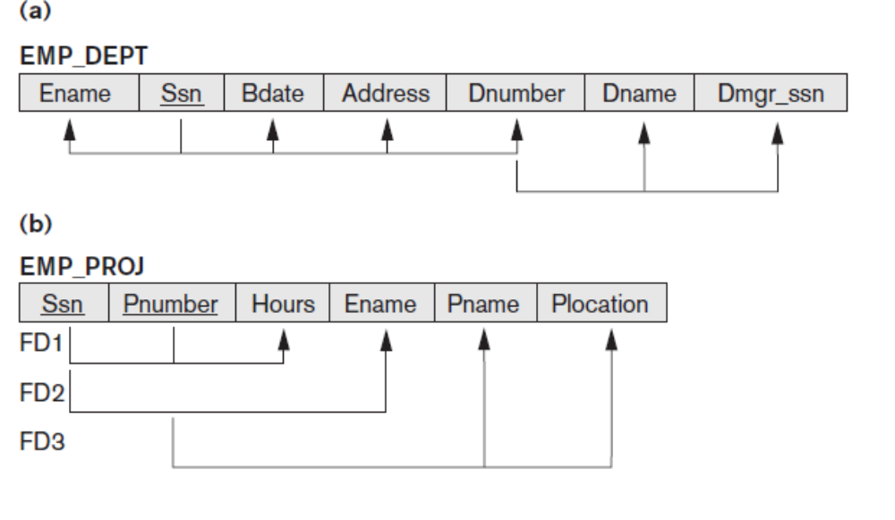
Examples of FD Constraints
Following figure introduces a diagrammatic notation for displaying FDs: Each FD is displayed as a horizontal line. The left-hand-side attributes of the FD are connected by vertical lines to the line representing the FD, whereas the right-hand-side attributes are connected by the lines with arrows pointing toward the attributes.
Jagdish Bhatta
Notes:
Jagidsh Bhatta

Slide 38
Inference Rules for FDs
Given a set of FDs F, we can infer additional FDs that hold whenever the FDs in F hold
Armstrong's inference rules:
IR1. (Reflexive) If Y subset-of X, then X -> Y
IR2. (Augmentation) If X -> Y, then XZ -> YZ
(Notation: XZ stands for X U Z)
IR3. (Transitive) If X -> Y and Y -> Z, then X -> Z
IR1, IR2, IR3 form a sound and complete set of inference rules. Sound means that from a given set of FDs F specified on relation schema R, any dependency that we can infer from F holds in every instance r of R that satisfies in F & complete means we can infer all possible dependencies from given set of FDs F.
Jagdish Bhatta
Notes:
Jagidsh Bhatta

Slide 39
Inference Rules for FDs
Some additional inference rules that are useful:
(Decomposition) If X -> YZ, then X -> Y and X -> Z
(Union) If X -> Y and X -> Z, then X -> YZ
(Psuedotransitivity) If X -> Y and WY -> Z, then WX -> Z
Jagdish Bhatta
Notes:
Jagidsh Bhatta

Slide 40
Inference Rules for FDs
Closure of a set F of FDs is the set F⁺ of all FDs that can be inferred from F. Using the inference rules F⁺ can be formed.
Closure of a set of attributes X with respect to F is the set X ⁺ of all attributes that are functionally determined by X.
X ⁺ can be calculated by repeatedly applying IR1, IR2, IR3 using the FDs in F
Algorithm: Determining X⁺ , the closure of X under F
X⁺ = X;
repeat
oldX⁺ = X^{+;}
for each functional dependency Y -> Z in F do
if Y subset-of X⁺ then X⁺ = X⁺ U Z;
until (X⁺ = old X⁺);
Jagdish Bhatta
Notes:
Jagidsh Bhatta

Slide 41
Example: Closure of set of FDs
R = (A, B, C, G, H, I)
F = { A → B
A → C
CG → H
CG → I
B → H}
Some members of F⁺
  A → H
    by transitivity from A → B and B → H
  AG → I
    by augmenting A → C with G, to get AG → CG
    and then transitivity with CG → I
  CG → HI
    from CG → H and CG → I : “union rule” can be inferred from
Jagdish Bhatta
Notes:
Jagidsh Bhatta

Slide 42
Example: Closure of set of Attributes
R = (A, B, C, G, H, I)
F = {A → B
A → C
CG → H
CG → I
B → H}
Now for (AG)⁺, using the algorithm we have
  1. result = {A,G}
  2. result = {A,B,C,G} (A → C and A → B)
  3. result = {A,B,C,G,H} (CG → H and CG ⊆ ABCG)
  result = ABCGHI (CG → I and CG ⊆ ABCGH)
  And so on…
Jagdish Bhatta
Notes:
Jagidsh Bhatta

Slide 43
Equivalence of sets of FDs
Two sets of FDs F and G are equivalent if:
- every FD in F can be inferred from G, and
- every FD in G can be inferred from F
Hence, F and G are equivalent if F ⁺ =G ⁺
i.e. if both of the conditions F covers G and G covers F holds.
A set of functional dependencies F is said to cover another set of functional dependencies G, F covers G, if every FD in G can be inferred from F (i.e., if G ⁺ subset-of F ⁺).
Jagdish Bhatta
Notes:
Jagidsh Bhatta

Slide 44
Normalization of Relations
Normalization: The process of decomposing unsatisfactory "bad" relations by breaking up their attributes into smaller relations.
Normalization of data can be looked upon as a process of analyzing the given relation schemas based on their FDs and primary keys to achieve the desirable properties of
(1) minimizing redundancy and
(2) minimizing the insertion, deletion, and update anomalies.
Normalization is carried out in practice so that the resulting designs are of high quality and meet the desirable properties
We have 1NF, 2NF, 3NF, BCNF based on keys and FDs of a relation schema and 4NF based on keys, multi-valued dependencies : MVDs; 5NF based on keys, join dependencies : JDs.
Jagdish Bhatta
Notes:
Jagidsh Bhatta

Slide 45
Importance of Normalization
Data consistency: Data consistency means that the data is always real and it is not ambiguous.
Data becomes nonredundant: Non-redundant means that only copy original copy of data is available for each user and for every time. There are no multiple copies of the same data for different persons. So when data is changed in one file and stay in one file. Then of course data is consistent and non-redundant. Here redundant is not the same as a backup of data, both are different things.
Jagdish Bhatta
Notes:
Jagidsh Bhatta

Slide 46
Importance of Normalization
Reduce insertion, deletion and updating anomalies:
  Insertion anomaly is an anomaly that occurs when we want to insert data into the database but the data is not completely or correctly inserted in the target attributes. If completely inserted in the database then not correctly entered.
  Deletion anomaly is an anomaly that occurs when we want to delete data in the database but the data is not completely or correctly deleted in the target attributes.
  Update anomaly is an anomaly that occurs when we want to update data in the database but the data is not completely or correctly updated in the target attributes.
Jagdish Bhatta
Notes:
Jagidsh Bhatta

Slide 47
Importance of Normalization
Database table compaction: When we normalize the database, we convert the large table into a smaller table that leads to data and table compaction. Compaction means to have the least and required size.
Isolation of Data: A good designed database states that the changes in one table or field do not affect other. This is achieved through Normalization.
Better performance
Jagdish Bhatta
Notes:
Jagidsh Bhatta

Slide 48
First Normal Form(1NF)
It states that domain of an attribute must include only atomic values.
Disallows composite attributes, multivalued attributes and nested relations; attributes whose values for an individual tuple are non-atomic.
It is considered to be part of the definition of relation
Jagdish Bhatta
Notes:
Jagidsh Bhatta

Slide 49
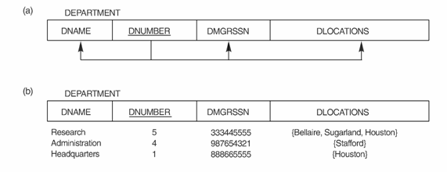
1NF: Example
Following example is not in normal form as attribute dlocation is multivalued.
Jagdish Bhatta
Notes:
Jagidsh Bhatta

Slide 50
1NF:Example
To resolve it into 1NF, remove the attribute DLocation that voilates the 1NF & place it in a separate relation, Dept_locations along with the primary key Dnumber of Department. The primary key of this relation is the combination {Dnumber, Dlocation}. Hence the normalized relations will be as:
DEPARTMENT (Dnumber, Dname, MgrSSN)
Dept_locations (Dnumber, Dlocation)
Jagdish Bhatta
Notes:
Jagidsh Bhatta

Slide 51
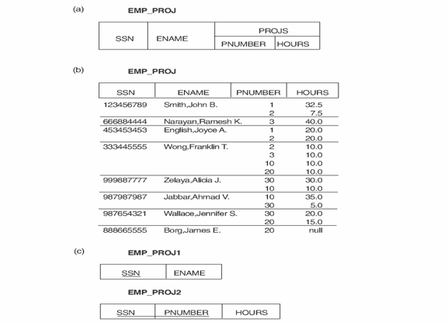
1NF:Example (Normalizing nested relations into 1NF )
Decomposing EMP_PROJ into 1NF relations EMP_PROJ1 and
EMP_PROJ2 by propagating the primary key.
Jagdish Bhatta
Notes:
Jagidsh Bhatta

Slide 52
Second Normal Form(2NF)
A relation schema R is in second normal form (2NF) if every non-prime attribute A in R is fully functionally dependent on the primary key.
R can be decomposed into 2NF relations via the process of 2NF normalization.
Prime attribute - attribute that is member of the primary key K
Full functional dependency - a FD Y -> Z where removal of any attribute from Y means the FD does not hold any more
Examples:- {SSN, PNUMBER} -> HOURS is a full FD since neither SSN -> HOURS nor PNUMBER -> HOURS hold
- {SSN, PNUMBER} -> ENAME is not a full FD (it is called a partial dependency ) since SSN -> ENAME also holds
Jagdish Bhatta
Notes:
Jagidsh Bhatta

Slide 53
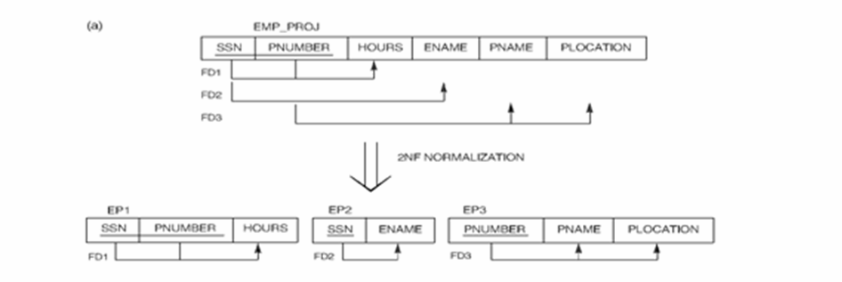
2NF: Example
Jagdish Bhatta
Notes:
Jagidsh Bhatta

Slide 54
Third Normal Form(3NF)
Transitive functional dependency - a FD X -> Z that can be derived from two FDs X -> Y and Y -> Z
Examples:
SSN -> DMGRSSN is a transitive FD since
SSN -> DNUMBER and DNUMBER -> DMGRSSN hold
SSN -> ENAME is non-transitive since there is no set of attributes X where SSN -> X and X -> ENAME
Jagdish Bhatta
Notes:
Jagidsh Bhatta

Slide 55
Third Normal Form(3NF)
A relation schema R is in third normal form (3NF) if it is in 2NF and no non-prime attribute A in R is transitively dependent on the primary key
R can be decomposed into 3NF relations via the process of 3NF normalization
NOTE:
In X -> Y and Y -> Z, with X as the primary key, we consider this a problem only if Y is not a candidate key. When Y is a candidate key, there is no problem with the transitive dependency .
E.g., Consider EMP (SSN, Emp#, Salary ).
Here, SSN -> Emp# -> Salary and Emp# is a candidate key.
Jagdish Bhatta
Notes:
Jagidsh Bhatta

Slide 56
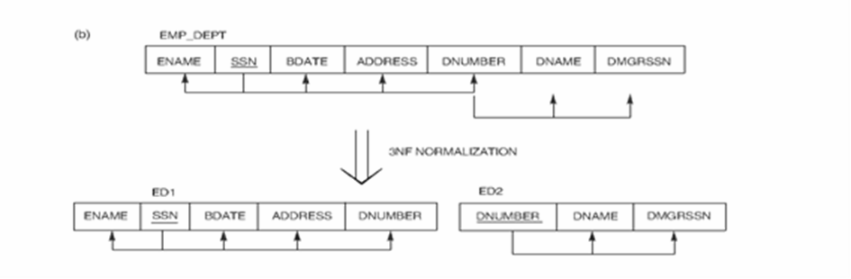
3NF: Example
Jagdish Bhatta
Notes:
Jagidsh Bhatta

Slide 57
Summary of 1NF, 2NF, 3NF
Normal Forms | Test | Remedy(Normalization)
1NF | Relation should have no nonatomic attributes of nested relations. | Form new relations for each nonatomic attribute or nested relation.
2NF | For relations where primary key contains multiple attributes, no nonkey attribute should be functionally dependent on a part of the primary key. | Decompose & set up a new relation for each partial key with its dependent attribute(s). Make sure to keep a relation with the original primary key and any attributes that are fully functionally dependent on it.
Jagdish Bhatta
Notes:
Jagidsh Bhatta

Slide 58
Summary of 1NF, 2NF, 3NF
Normal Forms | Test | Remedy(Normalization)
3NF | Relation should not have a nonkey attribute functionally determined by another nonkey attribute (or by a set of nonkey attributes). That is, there should be no transitive dependency of a nonkey attribute on the primary key. | Decompose & set up a relation that includes the nonkey attribute(s) that functionally determine(s) other nonkey attribute(s).
Jagdish Bhatta
Notes:
Jagidsh Bhatta

Slide 59
Boyce-Codd Normal Form (BCNF)
A relation schema R is in Boyce-Codd Normal Form (BCNF) if whenever any non-trivial functional dependency X → A holds in R, then X is a superkey of R.
BCNF was proposed as a simpler form of 3NF, but it was found to be stricter than 3NF. i.e every relation in BCNF is also in 3NF ;however, a relation in 3NF is not necessarily in BCNF. Thus a relation in BCNF should be in 3NF.
In practice, most relation schemas that are in 3NF are also in BCNF. Only if there exists some functional dependency X → A that holds in a relation schema R with X not being a superkey and A being a prime attribute will R be in 3NF but not in BCNF.
Jagdish Bhatta
Notes:
Jagidsh Bhatta

Slide 60
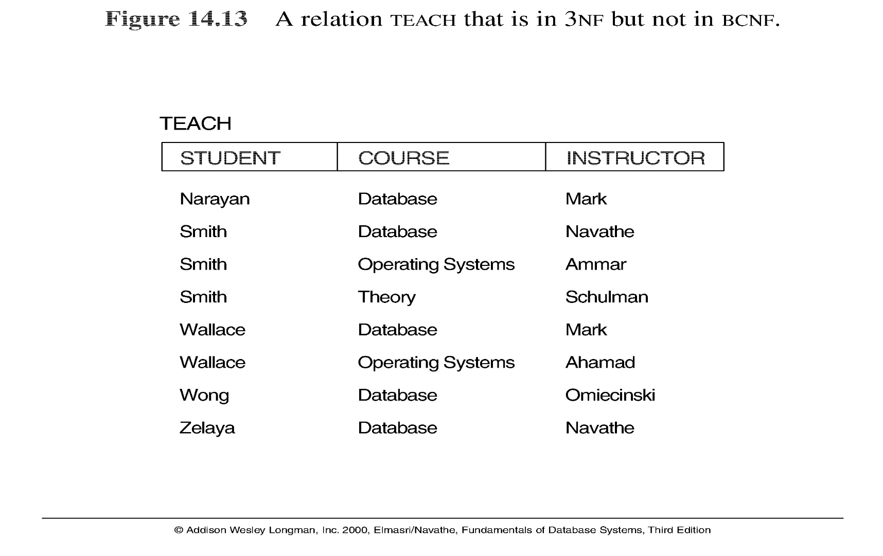
Boyce-Codd Normal Form (BCNF)
Example: Relation TEACH with {student, course} as a candidate key and having following two dependencies;
FD1: {Student, Course}→ Instructor FD2: Instructor → Course
Jagdish Bhatta
Notes:
Jagidsh Bhatta

Slide 61
Boyce-Codd Normal Form (BCNF)
The relation Teach is in 3NF but not in BCNF.
A relation NOT in BCNF should be decomposed so as to meet this property, while possibly forgoing the preservation of all functional dependencies in the decomposed relations
Three possible decompositions for relation TEACH
  {student, instructor} and {student, course}
  {course, instructor } and {course, student}
  {instructor, course } and {instructor, student}
All three decompositions will lose FD1. We have to settle for sacrificing the functional dependency preservation. But we cannot sacrifice the non-additivity property after decomposition.
Out of the above three, only the 3rd decomposition will not generate spurious tuples after join.(and hence has the non-additivity property).
Jagdish Bhatta
Notes:
Jagidsh Bhatta

Slide 62
Boyce-Codd Normal Form (BCNF)
In general, a relation R not in BCNF can be decomposed so as to meet the nonadditive join property by the following procedure. It decomposes R successively into a set of relations that are in BCNF:
Let R be the relation not in BCNF, let X ⊆ R, and let X → A be the FD that causes a violation of BCNF. R may be decomposed into two relations:
  R – A
  XA
If either R –A or XA. is not in BCNF, repeat the process.
Hence, in previous example in slide number 38, the proper decomposition of TEACH into BCNF relations is:
TEACH1 (Instructor, Course) and TEACH2 (Instructor, Student)
Jagdish Bhatta
Notes:
Jagidsh Bhatta

Slide 63
Decomposition
Consider a universal relation schema R={A₁, A_{2,} …, A_{n}}.
Decomposition: The process of decomposing the universal relation schema R into a set of relation schemas D = {R₁,R₂, …, R_{m}} that will become the relational database schema; D is called a decomposition of R.
Each attribute in R will appear in at least one relation schema R_{i} in the decomposition so that no attributes are “lost”.
i.e R = R1 υ R2 υ R₃ υ…… υ R_{m}
Another goal of decomposition is to have each individual relation R_{i} in the decomposition D be in BCNF or 3NF.
Additional properties of decomposition are needed to prevent from generating spurious tuples
Jagdish Bhatta
Notes:
Jagidsh Bhatta

Slide 64
Properties of Relational Decomposition
Dependency Preservation Property of a Decomposition
Definition:
Given a set of dependencies F on R, the projection of F on R_{i}, denoted by π_{Ri}(F) where R_{i} is a subset of R, is the set of dependencies X  Y in F⁺ such that the attributes in X  Y are all contained in R_{i}. Hence, the projection of F on each relation schema R_{i} in the decomposition D is the set of functional dependencies in F⁺, the closure of F, such that all their left- and right-hand-side attributes are in R_{i}.
Jagdish Bhatta
Notes:
Jagidsh Bhatta

Slide 65
Properties of Relational Decomposition
Dependency Preservation Property of a Decomposition:
  a decomposition D = {R₁, R₂, ..., R_{m}} of R is dependency-preserving with respect to F if the union of the projections of F on each R_{i} in D is equivalent to F; that is, ((π_{R1}(F)) υ . . . υ (π_{Rm}(F)))⁺ = F⁺
  If the decomposition is not dependency preserving some dependency is lost in the decomposition.
Claim 1: It is always possible to find a dependency-preserving decomposition D with respect to F such that each relation R_{i} in D is in 3NF
Jagdish Bhatta
Notes:
Jagidsh Bhatta

Slide 66
Properties of Relational Decomposition
Lossless (Nonadditive) Join Property:
  a decomposition D = {R₁, R₂, ..., R_{m}} of R has the lossless (nonadditive) join property with respect to the set of dependencies F on R if, for every relation state r of R that satisfies F, the following holds,
  * (π_{R1}(r), ..., π_{Rm}(r)) = r ; where * is the natural join of all the relations in D:
  In other words, if we can recover original relation from decomposed relations then lossless property holds.
  Note: The word loss in lossless refers to loss of information, not to loss of tuples. In fact, for “loss of information” a better term is “addition of spurious information”. So, if a decomposition does not have this property then we may get the spurious tuples after the project and natural join operations.
Jagdish Bhatta
Notes:
Jagidsh Bhatta

Slide 67
Properties of Relational Decomposition
Lossless (Nonadditive) Join Property:
  Thus a decomposition is lossless if the joining attribute is a superkey in at least one of the new relations obtained after decomposition.
  Formally,
  A decomposition of R into R₁ and R₂ is lossless join if and only if at least one of the following dependencies is in F⁺:
  R₁ ∩ R₂ → R₁
  R₁ ∩ R₂ → R₂
  i.e. R₁ ∩ R₂ forms a superkey of either R₁ or R₂
Jagdish Bhatta
Notes:
Jagidsh Bhatta

Slide 68
Multivalued Dependency
Let R be a relation schema and let α ⊆ R and β ⊆ R. The multivalued dependency
α →→ β
holds on R if in any legal relation r(R), for all pairs for tuples t₁ and t₂ in r such that t₁[α] = t₂ [α], there exist tuples t₃ and t₄ in r such that:
t₁[α] = t₂ [α] = t₃ [α] = t₄ [α]
t₃[β] = t₁ [β]
t₃[Z] = t₂[Z]
t₄ [β] = t₂[β]
t₄[Z] = t₁[Z] ; where Z = R – (α υ β)
A multivalued dependency can be trivial or non-trivial. It is trivial if
β ⊆ α or α υ β = R. Otherwise it is non-trivial.
Jagdish Bhatta
Notes:
Jagidsh Bhatta

Slide 69
Multivalued Dependency
A relation is said to have multi-valued dependency, if the following conditions are true;
  For a dependency A → B, if for a single value of A, multiple value of B exists, then the relation may have multi-valued dependency, A→→ B.
  Also, a relation should have at-least 3 columns for it to have a multi-valued dependency.
  And, for a relation R(A,B,C), if there is a multi-valued dependency between, A and B, then B and C should be independent of each other.
If all these conditions are true for any relation(table), it is said to have multi-valued dependency.
Jagdish Bhatta
Notes:
Jagidsh Bhatta

Slide 70
Multivalued Dependency
Below we have a college enrolment table with columns SID, Course and Hobby.
As you can see in the table above, student with SID 1 has opted for two courses, Science and Maths, and has two hobbies, Cricket and Hockey.
Here it exists multivalued dependency SID →→ Course & SID→→ Hobby
SID | Course | Hobby
1 | Science | Cricket
1 | Maths | Hockey
2 | DBMS | Cricket
2 | PHP | Hockey
Jagdish Bhatta
Notes:
Jagidsh Bhatta

Slide 71
Multivalued Dependency
Example:
Emp
Here we have Ename →→ Pname & Ename →→ Dependent_name
Ename | Pname | Dependent_name
Ram | X | Rakesh
Ram | Y | Rao
Ram | X | Rao
Ram | Y | Rakesh
Jagdish Bhatta
Notes:
Jagidsh Bhatta

Slide 72
Fourth Normal Form(4NF)
A relation schema R is in 4NF with respect to a set of dependencies F (that includes functional dependencies and multivalued dependencies) if, for every nontrivial multivalued dependency X →→ Y in F+,21 X is a superkey for R.
Or, equivalently;
A relation schema R is in 4NF with respect to a set D of functional and multivalued dependencies if for all multivalued dependencies in D⁺ of the form α →→ β, where α ⊆ R and β ⊆ R, at least one of the following hold:
  α →→ β is trivial (i.e., β ⊆ α or α ∪ β = R)
  α is a superkey for schema R
If a relation is in 4NF it is in BCNF.
Jagdish Bhatta
Notes:
Jagidsh Bhatta

Slide 73
Fourth Normal Form(4NF)
4NF is violated when a relation has undesirable multivalued dependencies and hence can be used to identify and decompose such relations.
For a relation to be in 4NF, it should satisfy the following two conditions:
  It should be in the Boyce-Codd Normal Form.
  It should not have any Multi-valued Dependency.
Jagdish Bhatta
Notes:
Jagidsh Bhatta

Slide 74
4NF: Example
Example:
Fig: Decomposing the relation into two 4NF relationss
SID | Course | Hobby
1 | Science | Cricket
1 | Maths | Hockey
2 | DBMS | Cricket
2 | PHP | Hockey
SID | Course
1 | Science
1 | Maths
2 | DBMS
2 | PHP
SID | Hobby
1 | Cricket
1 | Hockey
2 | Cricket
2 | Hockey
Jagdish Bhatta
Notes:
Jagidsh Bhatta

Slide 75
4NF: Example
Example: Emp
Emp_Projects Emp_Dependents
Fig: Decomposing the Emp relation into two 4NF relationss
Ename | Pname | Dependent_name
Ram | X | Rakesh
Ram | Y | Rao
Ram | X | Rao
Ram | Y | Rakesh
Ename | Pname
Ram | X
Ram | Y
Ename | Dependent_name
Ram | Rakesh
Ram | Rao
Jagdish Bhatta
Notes:
Jagidsh Bhatta

Slide 76
Properties of Relational Decompositions
Relation Decomposition and Insufficiency of Normal Forms
The relational database design algorithms that we present in start from a single universal relation schema R = {A1, A2, … , An} that includes all the attributes of the database. We implicitly make the universal relation assumption, which states that every attribute name is unique. The set F of functional dependencies that should hold on the attributes of R is specified by the database designers and is made available to the design algorithms. Using the functional dependencies, the algorithms decompose the universal relation schema R into a set of relation schemas D = {R1, R2, … , Rm} that will become the relational database schema; D is called a decomposition of R.
Jagdish Bhatta
Notes:
Jagidsh Bhatta

Slide 77
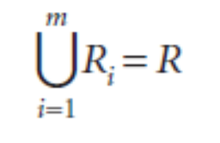
Properties of Relational Decompositions
Relation Decomposition and Insufficiency of Normal Forms
We must make sure that each attribute in R will appear in at least one relation schema Ri in the decomposition so that no attributes are lost; formally, we have
This is called the attribute preservation condition of a decomposition.
Jagdish Bhatta
Notes:
Jagidsh Bhatta

Slide 78
Properties of Relational Decompositions
Relation Decomposition and Insufficiency of Normal Forms
Another goal is to have each individual relation Ri in the decomposition D be in BCNF or 3NF. However, this condition is not sufficient to guarantee a good database design on its own. We must consider the decomposition of the universal relation as a whole, in addition to looking at the individual relations.
Jagdish Bhatta
Notes:
Jagidsh Bhatta

Slide 79
Properties of Relational Decompositions
Dependency Preservation Property of a Decomposition
It would be useful if each functional dependency X → Y specified in F either appeared directly in one of the relation schemas Ri in the decomposition D or could be inferred from the dependencies that appear in some Ri. Informally, this is the dependency preservation condition. We want to preserve the dependencies because each dependency in F represents a constraint on the database. If one of the dependencies is not represented in some individual relation Ri of the decomposition, we cannot enforce this constraint by dealing with an individual relation. We may have to join multiple relations so as to include all attributes involved in that dependency.
Jagdish Bhatta
Notes:
Jagidsh Bhatta

Slide 80
Properties of Relational Decompositions
Dependency Preservation Property of a Decomposition
It is not necessary that the exact dependencies specified in F appear themselves in individual relations of the decomposition D. It is sufficient that the union of the dependencies that hold on the individual relations in D be equivalent to F. We now define these concepts more formally.
Jagdish Bhatta
Notes:
Jagidsh Bhatta

Slide 81
Properties of Relational Decompositions
Dependency Preservation Property of a Decomposition
Given a set of dependencies F on R, the projection of F on Ri, denoted by πRi(F) where Ri is a subset of R, is the set of dependencies X → Y in F+ such that the attributes in X ∪ Y are all contained in Ri. Hence, the projection of F on each relation schema Ri in the decomposition D is the set of functional dependencies in F+, the closure of F, such that all the left- and right-hand-side attributes of those dependencies are in Ri. We say that a decomposition D = {R1, R2, … , Rm} of R is dependency-preserving with respect to F if the union of the projections of F on each Ri in D is equivalent to F; that is, ((πR1(F)) ∪ K ∪ (πRm(F)))+ = F+.
Jagdish Bhatta
Notes:
Jagidsh Bhatta

Slide 82
Properties of Relational Decompositions
Dependency Preservation Property of a Decomposition
If a decomposition is not dependency-preserving, some dependency is lost in the decomposition. To check that a lost dependency holds, we must take the JOIN of two or more relations in the decomposition to get a relation that includes all left- and right-hand-side attributes of the lost dependency, and then check that the dependency holds on the result of the JOIN—an option that is not practical.
Jagdish Bhatta
Notes:
Jagidsh Bhatta

Slide 83
Properties of Relational Decompositions
Nonadditive (Lossless) Join Property of a Decomposition
Another property that a decomposition D should possess is the nonadditive join property, which ensures that no spurious tuples are generated when a NATURAL JOIN operation is applied to the relations resulting from the decomposition.
Because this is a property of a decomposition of relation schemas, the condition of no spurious tuples should hold on every legal relation state—that is, every relation state that satisfies the functional dependencies in F. Hence, the lossless join property is always defined with respect to a specific set F of dependencies.
Jagdish Bhatta
Notes:
Jagidsh Bhatta

Slide 84
Properties of Relational Decompositions
Nonadditive (Lossless) Join Property of a Decomposition
Formally, a decomposition D = {R1, R2, … , Rm} of R has the lossless (nonadditive) join property with respect to the set of dependencies F on R if, for every relation state r of R that satisfies F, the following holds, where * is the NATURAL JOIN of all the relations in D: *(πR1(r), … , πRm(r)) = r.
Jagdish Bhatta
Notes:
Jagidsh Bhatta

Slide 85
Properties of Relational Decompositions
Nonadditive (Lossless) Join Property of a Decomposition
The word loss in lossless refers to loss of information, not to loss of tuples. If a decomposition does not have the lossless join property, we may get additional spurious tuples after the PROJECT (π) and NATURAL JOIN (*) operations are applied; these additional tuples represent erroneous or invalid information. We prefer the term nonadditive join because it describes the situation more accurately.
The nonadditive join property ensures that no spurious tuples result after the application of PROJECT and JOIN operations. We may, however, sometimes use the term lossy design to refer to a design that represents a loss of information.
Jagdish Bhatta
Notes:
Jagidsh Bhatta

Slide 86
Examples of Normalization
Jagdish Bhatta
Notes:
Jagidsh Bhatta

Slide 87
1NF: Example
MP_ID | EMP_NAME | EMP_PHONE | EMP_STATE
14 | John | 7272826385, 9064738238 | UP
20 | Harry | 8574783832 | Bihar
12 | Sam | 7390372389, 8589830302 | Punjab
Jagdish Bhatta

Slide 88
1NF: Solution Example
EMP_ID | EMP_NAME | EMP_STATE
14 | John | UP
20 | Harry | Bihar
12 | Sam | Punjab
EMP_ID | EMP_PHONE
14 | 7272826385
14 | 9064738238
20 | 8574783832
12 | 7390372389
12 | 8589830302
Jagdish Bhatta

Slide 89
2NF: Example
Employee No | Department No | Employee Name | Department
1 | 101 | Amit | OBIEE
2 | 102 | Divya | COGNOS
3 | 101 | Rama | OBIEE
Given FD:
{Employee NO, Department No}-> Employee Name
Department No-> Department
Jagdish Bhatta

Slide 90
2NF: Solution Example
Employee No | Department No | Employee Name
1 | 101 | Amit
2 | 102 | Divya
3 | 101 | Rama
Department No | Department
101 | OBIEE
102 | COGNOS
Jagdish Bhatta

Slide 91
3NF: Example
Employee No | Salary Slip No | Employee Name | Salary
1 | 0001 | Amit | 50000
2 | 0002 | Divya | 40000
3 | 0003 | Rama | 57000
Given FD:
Employee No-> Employee Name, Salary Slip No
Salary Slip No -> Salary
Jagdish Bhatta

Slide 92
3NF: Solution Example
Employee No | Salary Slip No | Employee Name
1 | 0001 | Amit
2 | 0002 | Divya
3 | 0003 | Rama
Salary Slip No | Salary
0001 | 50000
0002 | 40000
0003 | 57000
Jagdish Bhatta

Slide 93
4NF: Example
Pizza Delivery Permutations
Restaurant | Pizza Variety | Delivery Area
A1 Pizza | Thick Crust | Springfield
A1 Pizza | Thick Crust | Shelbyville
A1 Pizza | Thick Crust | Capital City
A1 Pizza | Stuffed Crust | Springfield
A1 Pizza | Stuffed Crust | Shelbyville
A1 Pizza | Stuffed Crust | Capital City
Elite Pizza | Thin Crust | Capital City
Elite Pizza | Stuffed Crust | Capital City
Vincenzo's Pizza | Thick Crust | Springfield
Vincenzo's Pizza | Thick Crust | Shelbyville
Vincenzo's Pizza | Thin Crust | Springfield
Vincenzo's Pizza | Thin Crust | Shelbyville
Jagdish Bhatta

Slide 94
4NF: Example
The dependencies are:
{Restaurant} →→{Pizza Variety}
{Restaurant} →→{Delivery Area}
Jagdish Bhatta

Slide 95
4NF: Solution Example
Restaurant | Pizza Variety
A1 Pizza | Thick Crust
A1 Pizza | Stuffed Crust
Elite Pizza | Thin Crust
Elite Pizza | Stuffed Crust
Vincenzo's Pizza | Thick Crust
Vincenzo's Pizza | Thin Crust
Restaurant | Delivery Area
A1 Pizza | Springfield
A1 Pizza | Shelbyville
A1 Pizza | Capital City
Elite Pizza | Capital City
Vincenzo's Pizza | Springfield
Vincenzo's Pizza | Shelbyville
Jagdish Bhatta

Slide 96
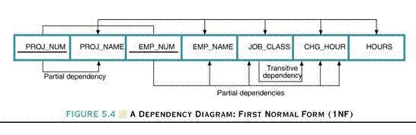
Normalization Example : 1NF
Jagdish Bhatta

Slide 97
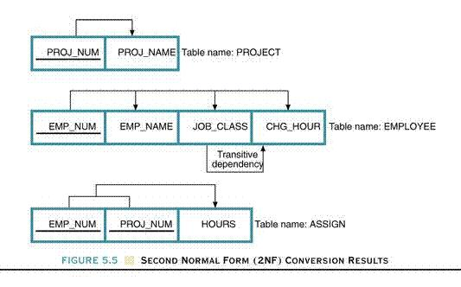
Normalization Example: 2NF Results
Jagdish Bhatta

Slide 98
Normalization Example: 3NF Results
Project (Proj_Num, Proj_name)
Employee( Emp_Num, Emp_name, Job_Class)
Job(Job_Class, CHG_Hour)
Assign(Emp_Num, Proj_Num, Hours)
Jagdish Bhatta

